Slide 1
AutoML Lab manual

Slide 2
Prerequisites
Sign into Power BI service using the credentials provided to you.

Slide 3
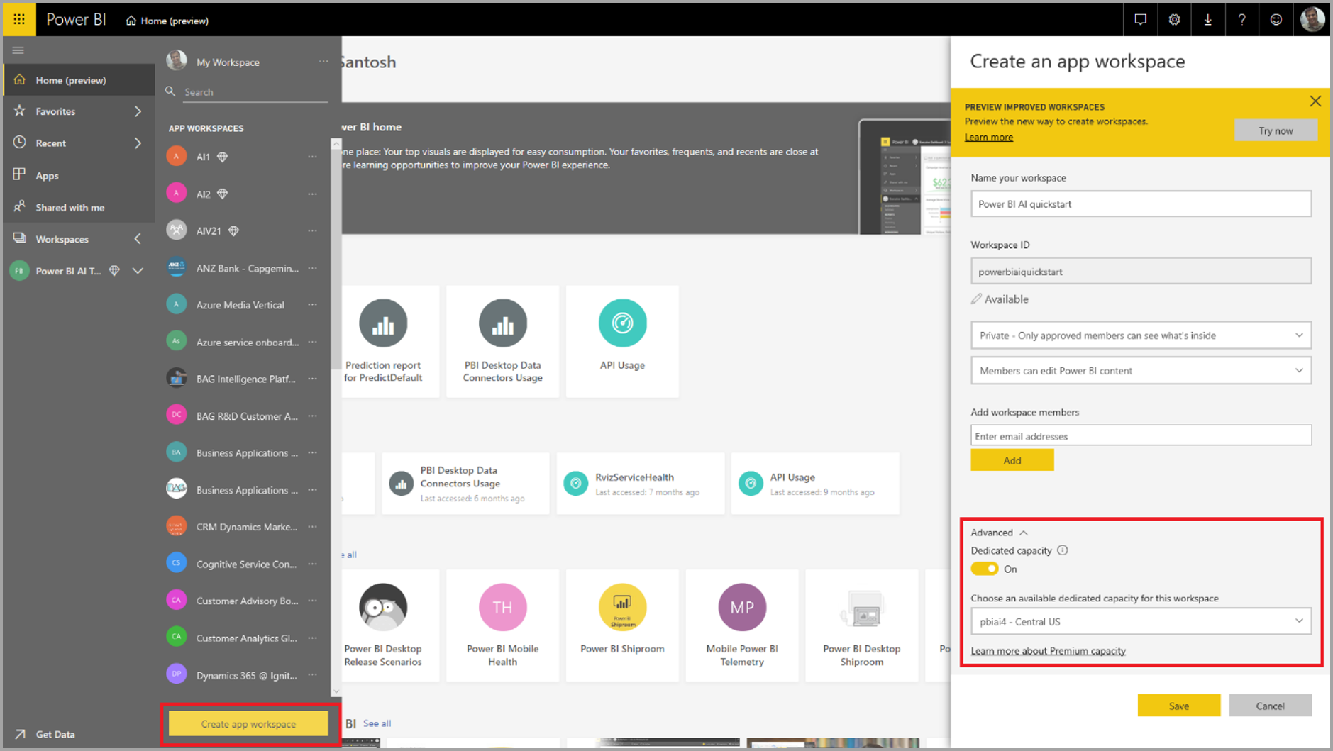
Objective: create dataflow with input data
Select Workspaces in the nav pane menu in the Power BI service,
Select Create workspace at the bottom of the panel that appears.
Enter a workspace name and select Advanced.
Confirm that the workspace uses Dedicated Capacity using the radio button, and that it's assigned to a dedicated capacity instance that has the AI preview turned on.
Then select Save.
Notes:

Slide 4
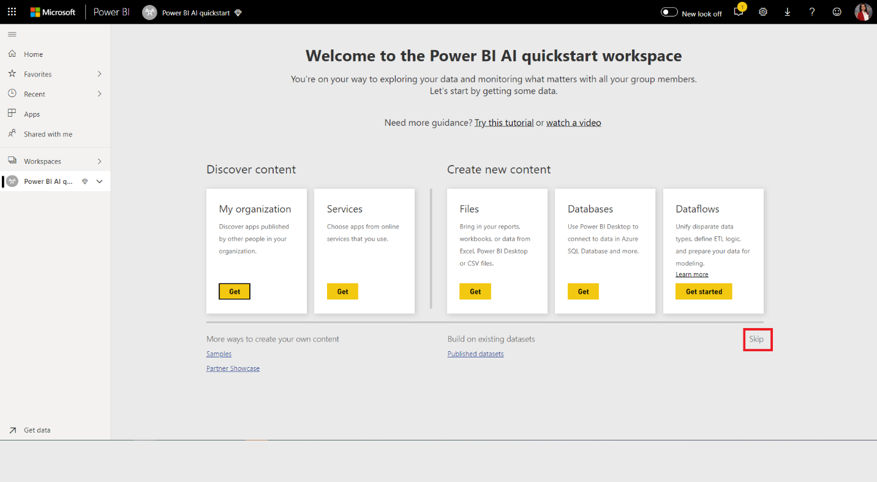
Select Skip in the bottom right of the Welcome screen
Notes:

Slide 5
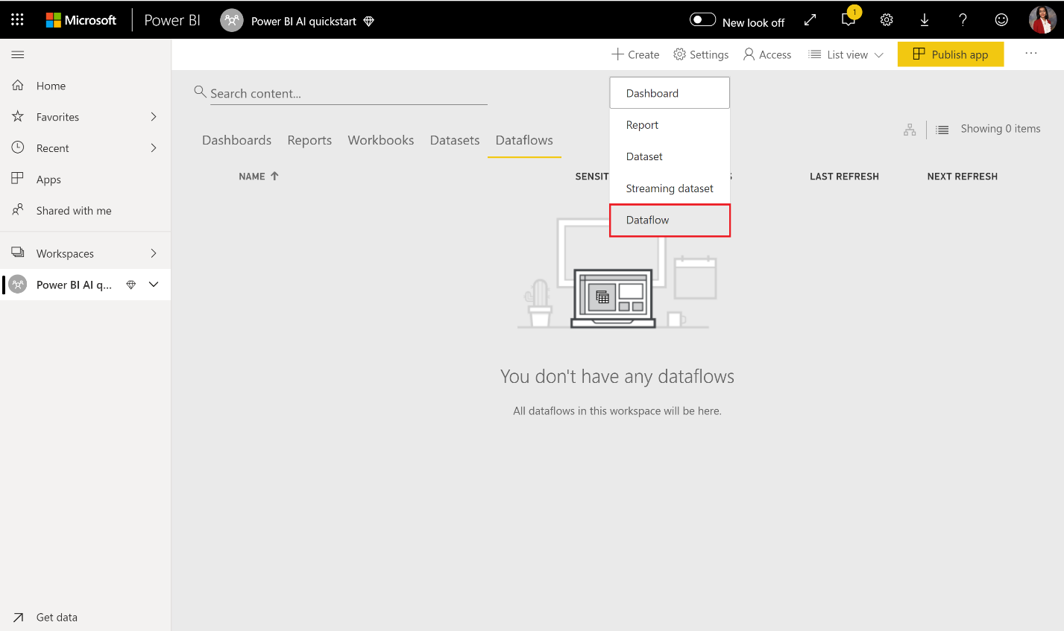
Objective: Create a new Dataflow
Select the Create button at the top right of the workspace, and then select Dataflow.
Notes:

Slide 6
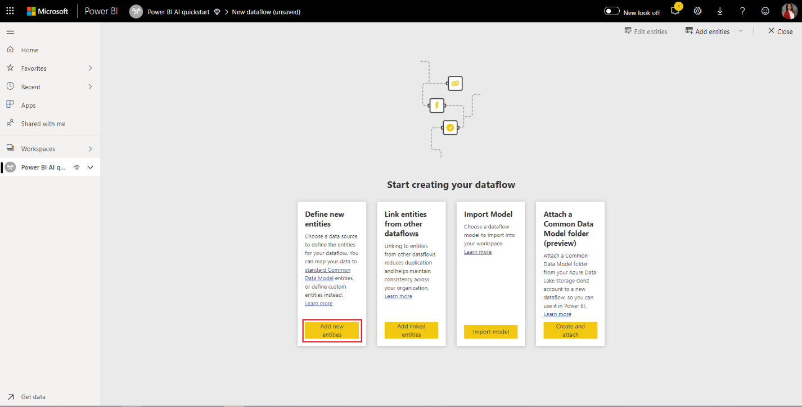
Objective: Add entities to the Dataflow
Select Add new entities.
Notes:

Slide 7
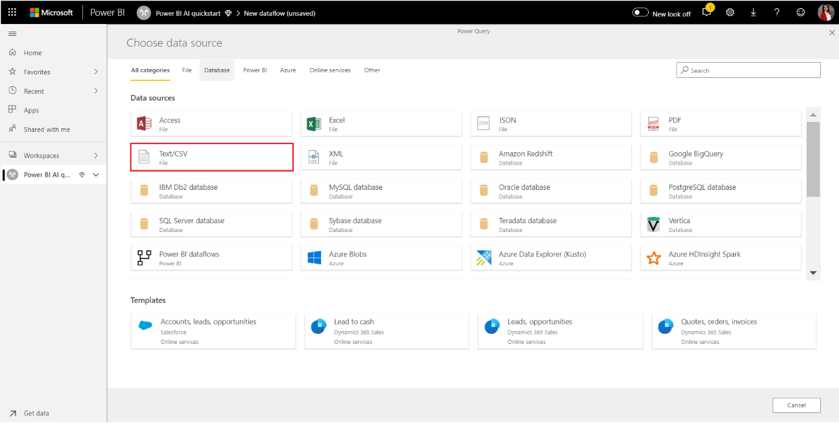
Objective: Import data
Select Text/CSV File as a data source
Notes:

Slide 8
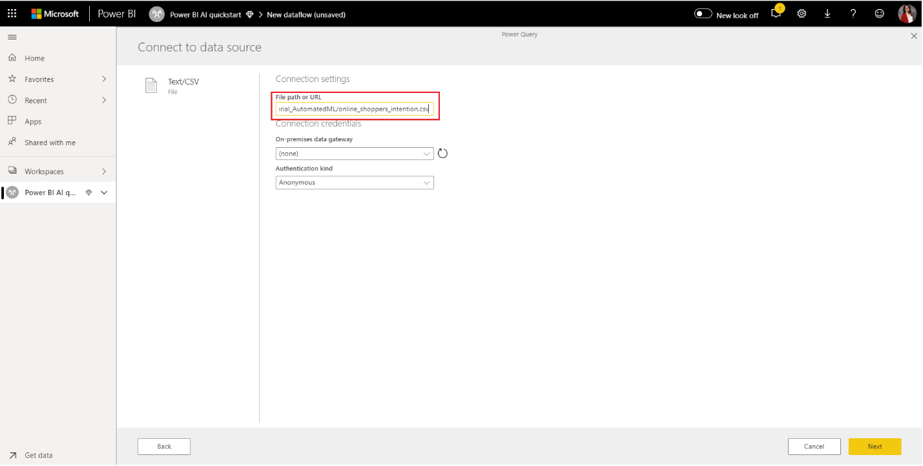
In the Connect to a data source page that appears next, paste the following link to the Customer Feedback.csv into the File path or URL box, and then select Next.
https://pbiaiperfstorage.blob.core.windows.net/publicblob/Customers Feedback.csv
Notes:

Slide 9
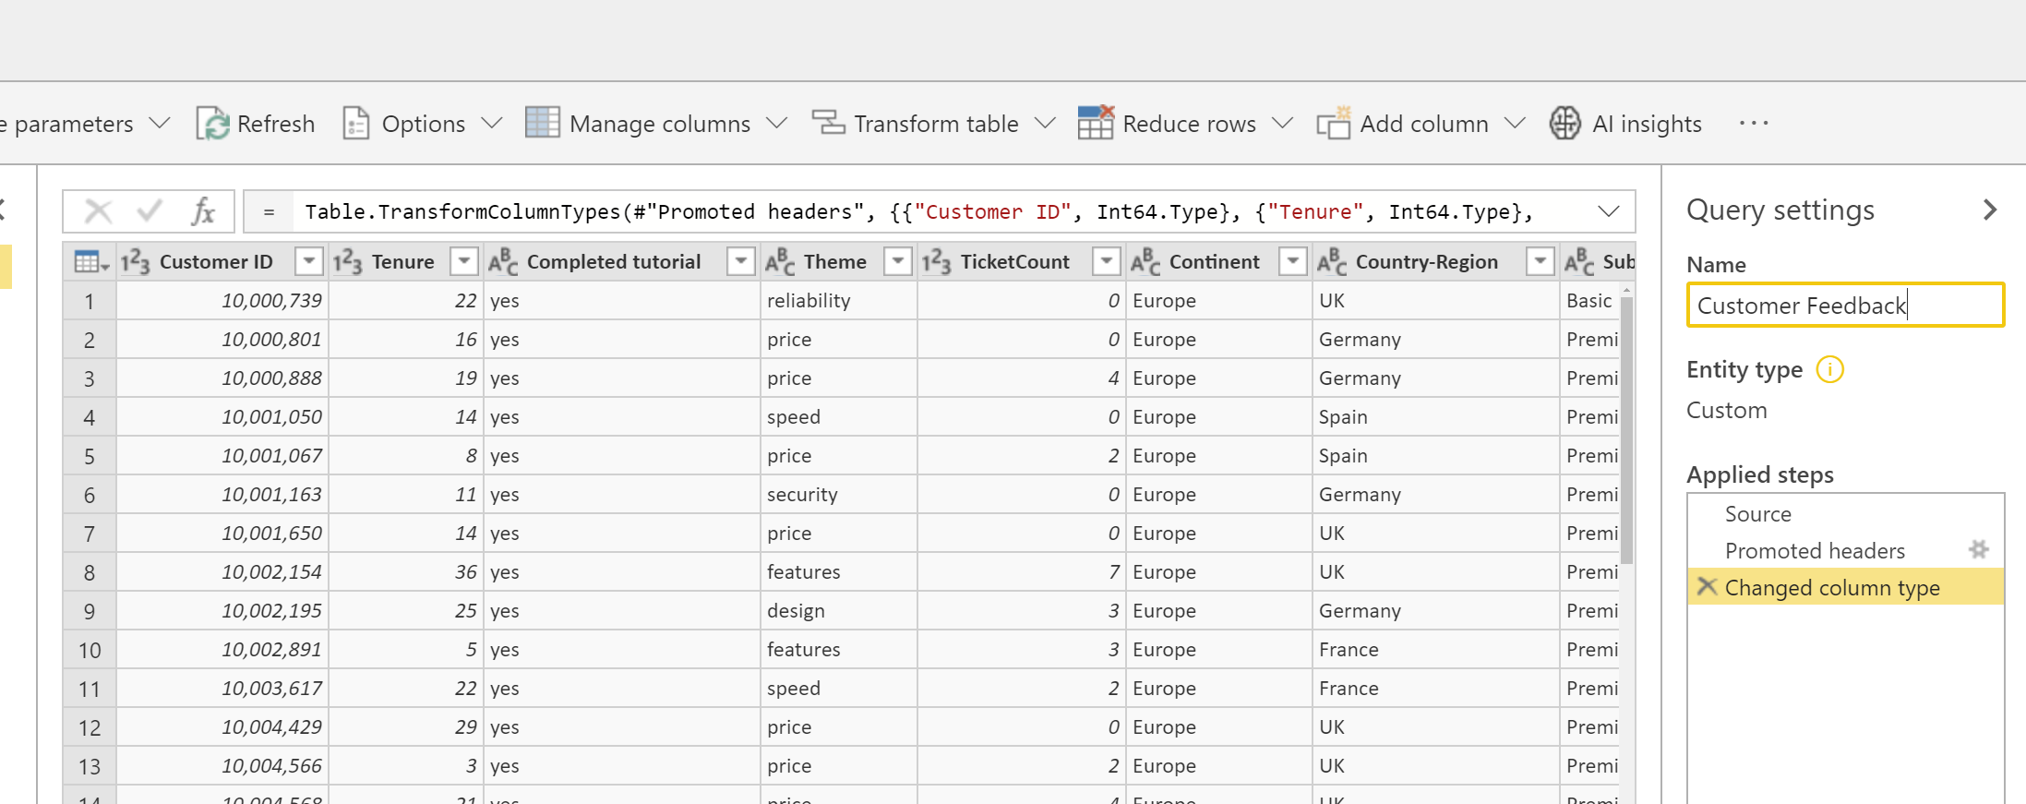
Objective: Name the created query
You may rename the query to a friendlier name by changing the value in the Name box found in the right pane. For example, you could change the Query name to Customer Feedback
Notes:

Slide 10
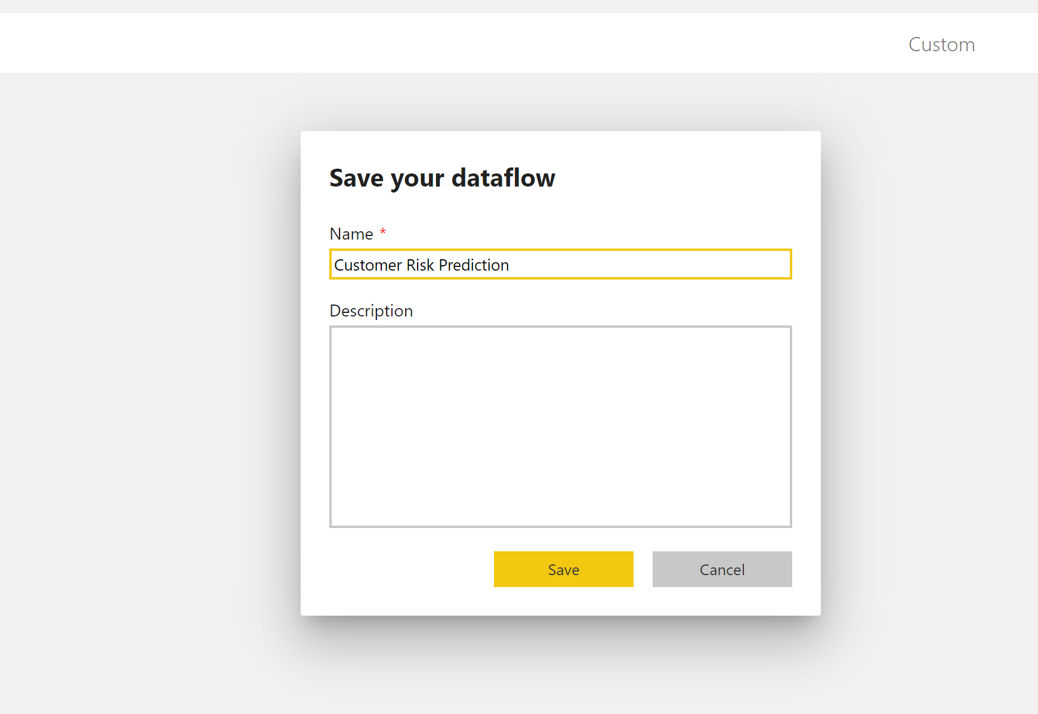
Objective: Save the Dataflow
Select the Save & close button to close Power Query Editor
Provide a name for the dataflow
Select Save on the dialog
Notes:

Slide 11
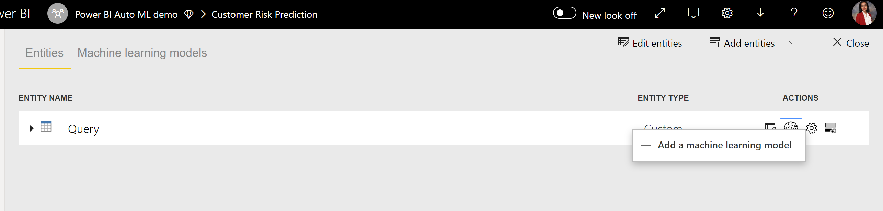
Objective: Add a Machine Learning model
To add a machine learning model, Select the Apply ML model button in the Actions list for the base entity that contains your training data and label information, and then select Add a machine learning model.
Notes:

Slide 12
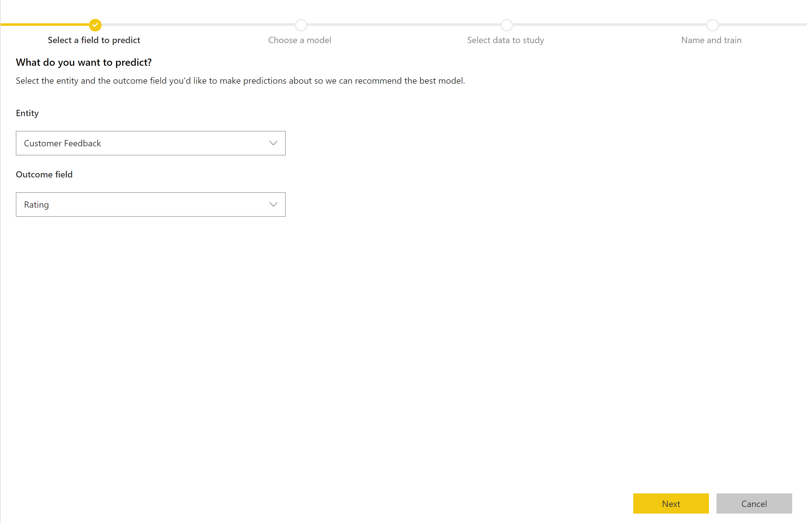
Objective: Select the field to predict
Select Rating as the 'Outcome field' value and then select Next.
Notes:

Slide 13
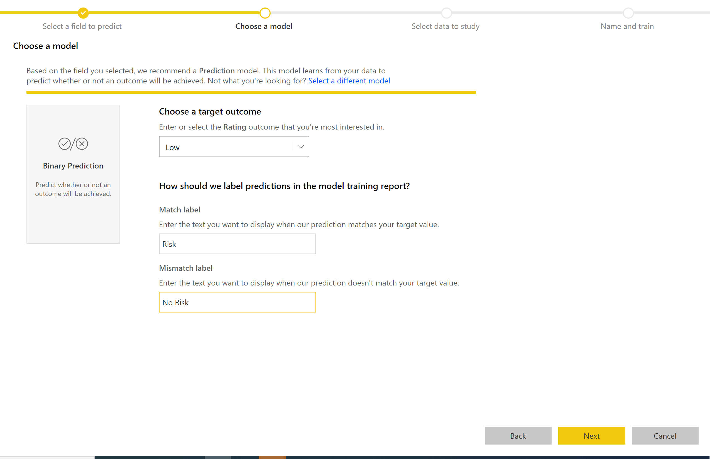
Objective: Select a target outcome
Select Low as the Rating outcome that you're most interested in.
Provide friendly labels for the outcomes to be used in the automatically generated report that will summarize the results of the model validation.
Then select Next.
Notes:

Slide 14
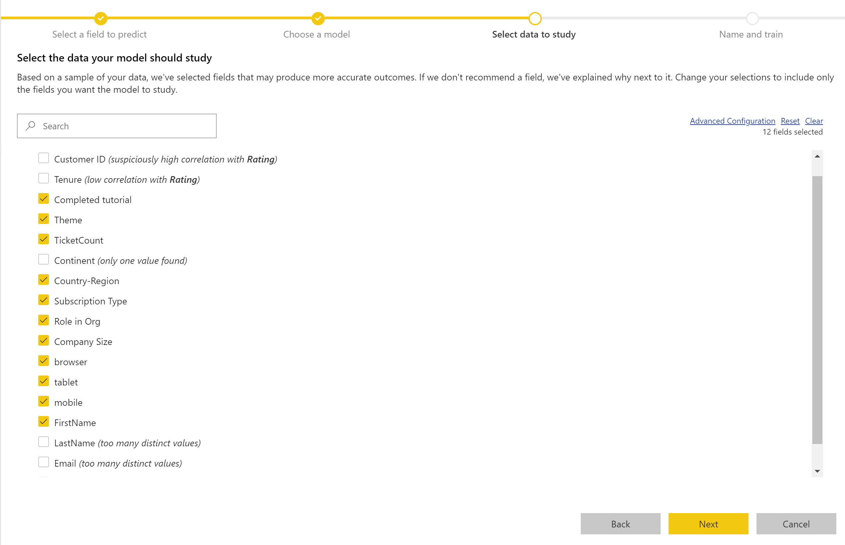
Objective: Select the data to study
Change the selections to include only the fields you want the model to study, or you can select all the fields by selecting the checkbox next to the entity name.
Select Next to accept the inputs.
Notes:

Slide 15
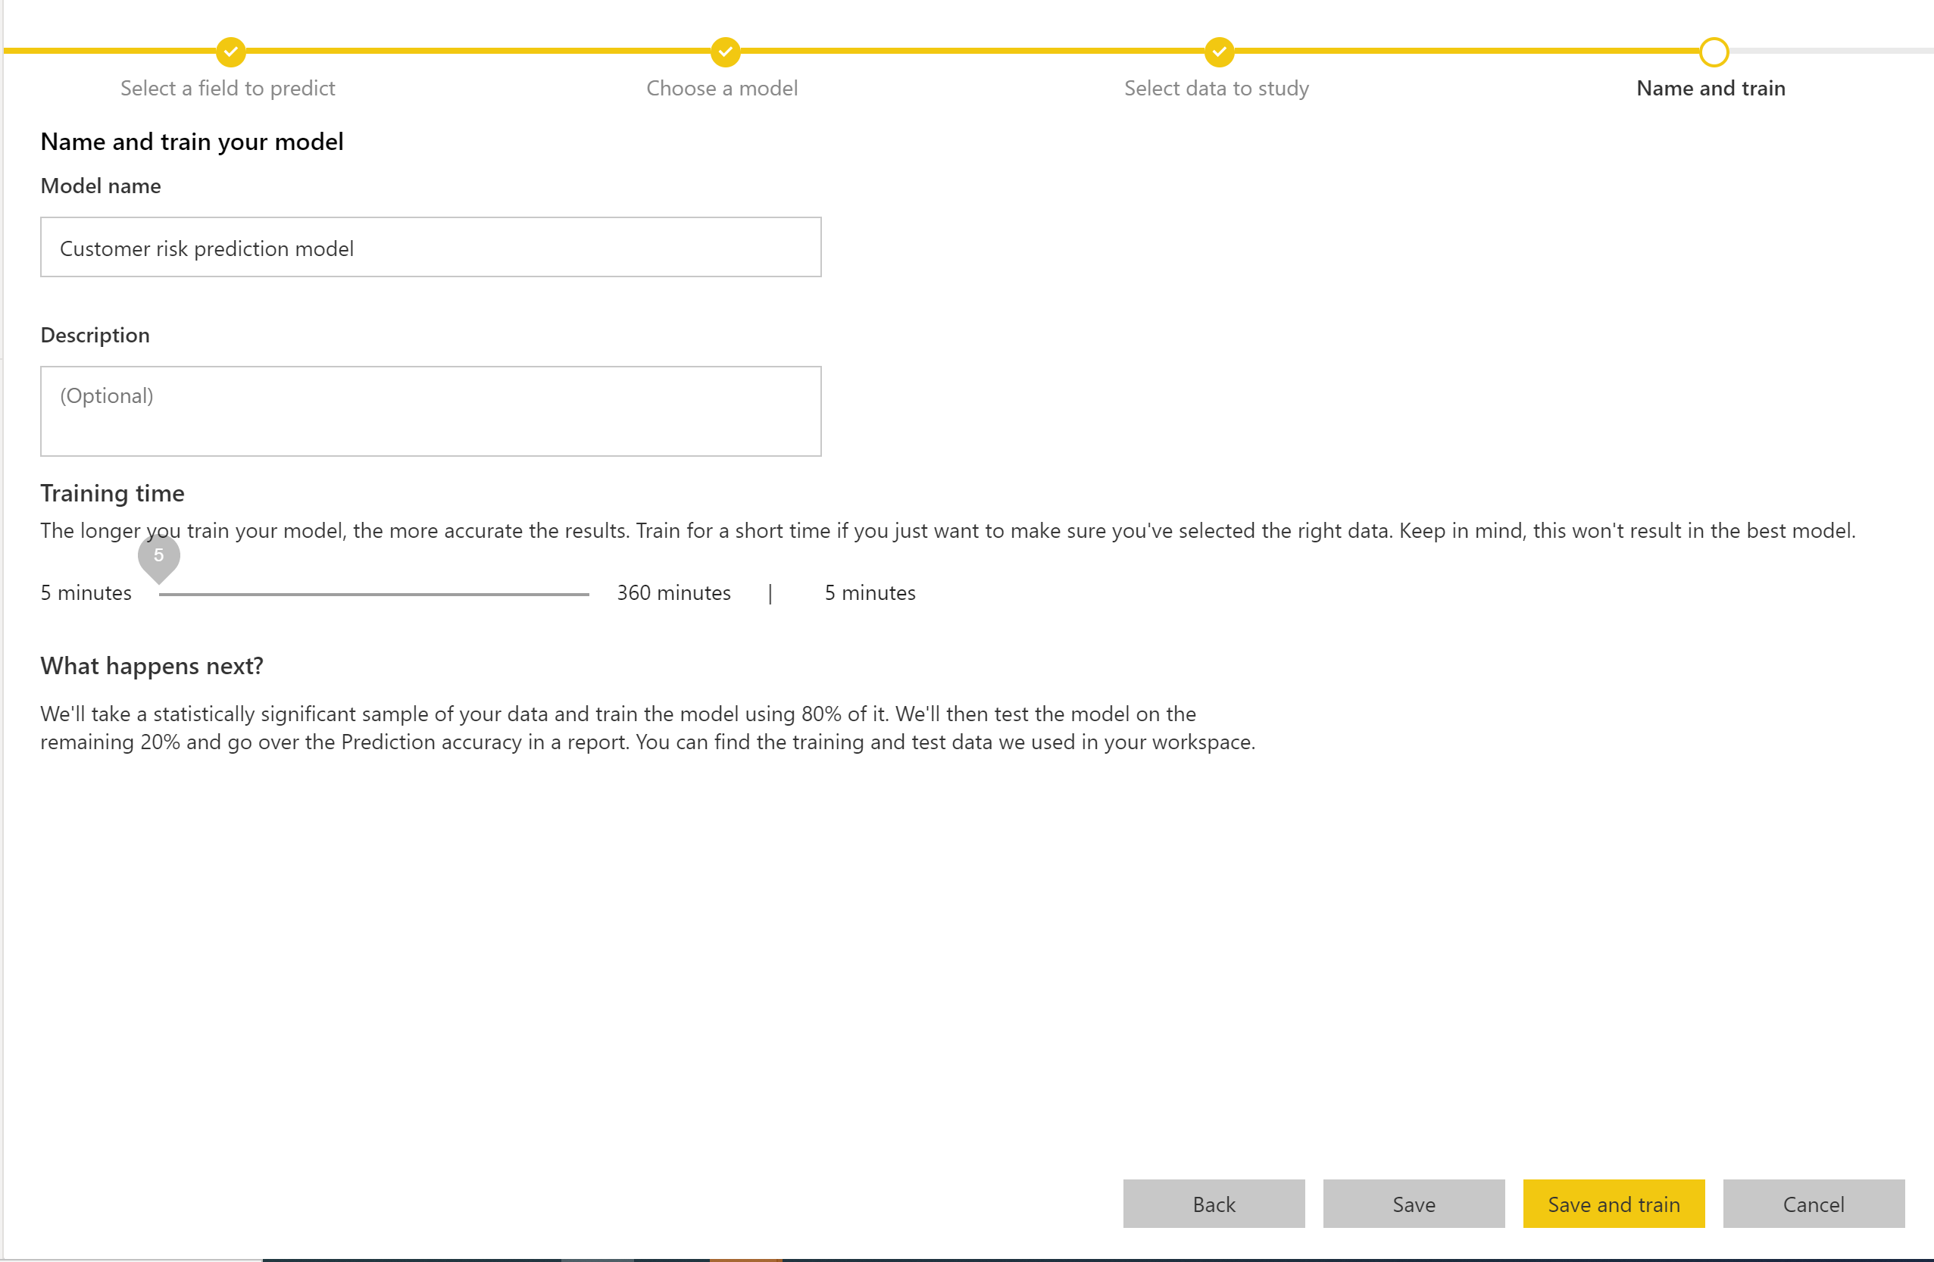
Objective: Save and Train the model
Name the model Customer Risk Prediction model.
You can choose to reduce the training time to see quick results or increase the amount of time spent in training to get the best model.
Then select Save and train to start training the model.
Notes:

Slide 16
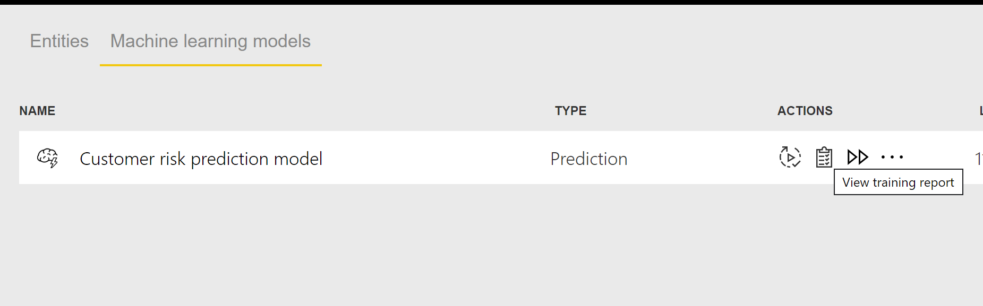
Objective: Review the model validation report
Select the View training report button in the Actions column for the model.
Notes:

Slide 17
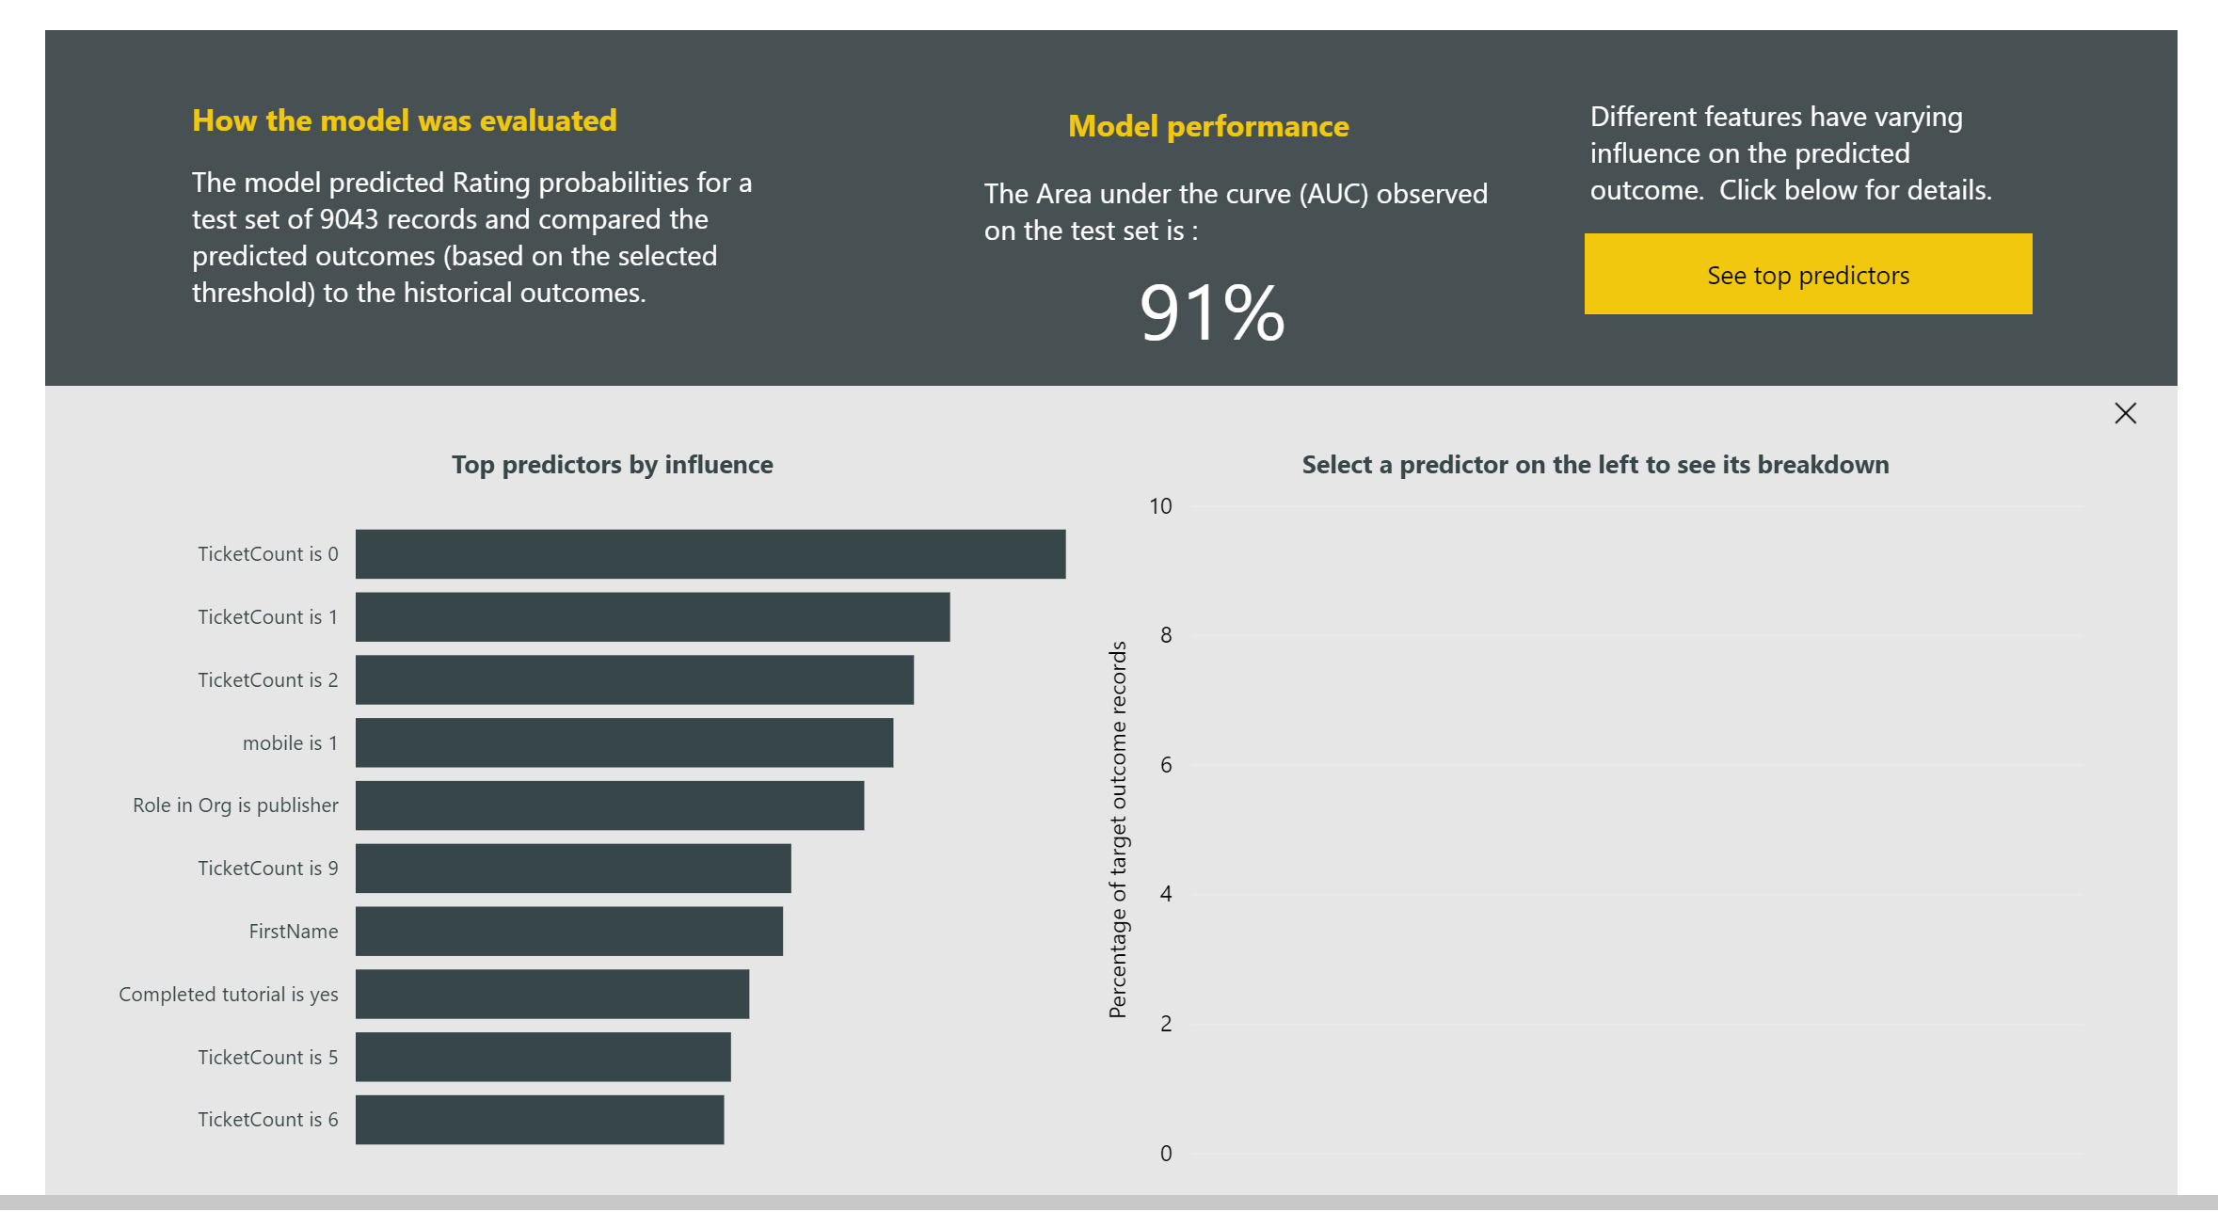
Objective: Review Model performance
In the Model Performance page of the report, select See top predictors to view the top predictors for your model.
Notes:

Slide 18
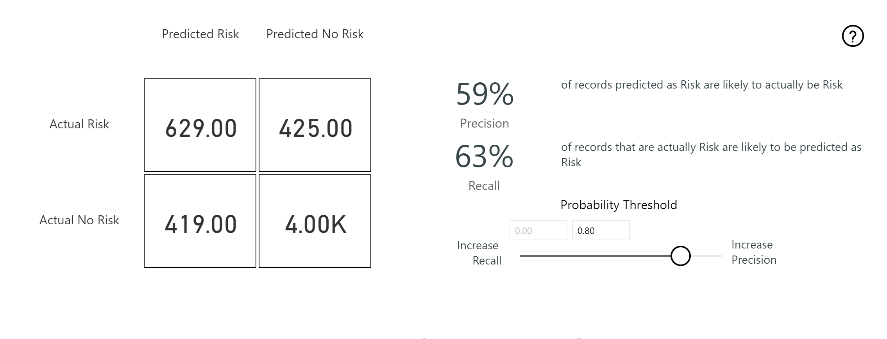
Objective: Review influence of probability threshold
You can use the Probability Threshold slicer on the Model Performance page to examine its influence on the Precision and Recall for the model.
Notes:

Slide 19
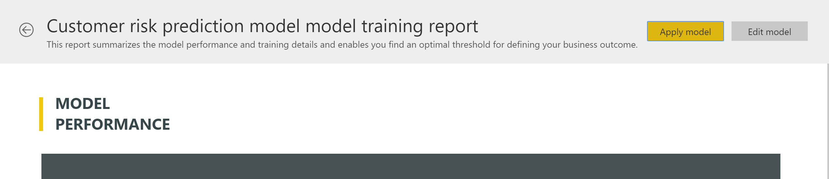
Objective: Apply the model to a dataflow entity
Select the Apply model button at the top of the report to invoke this model.
Notes:

Slide 20
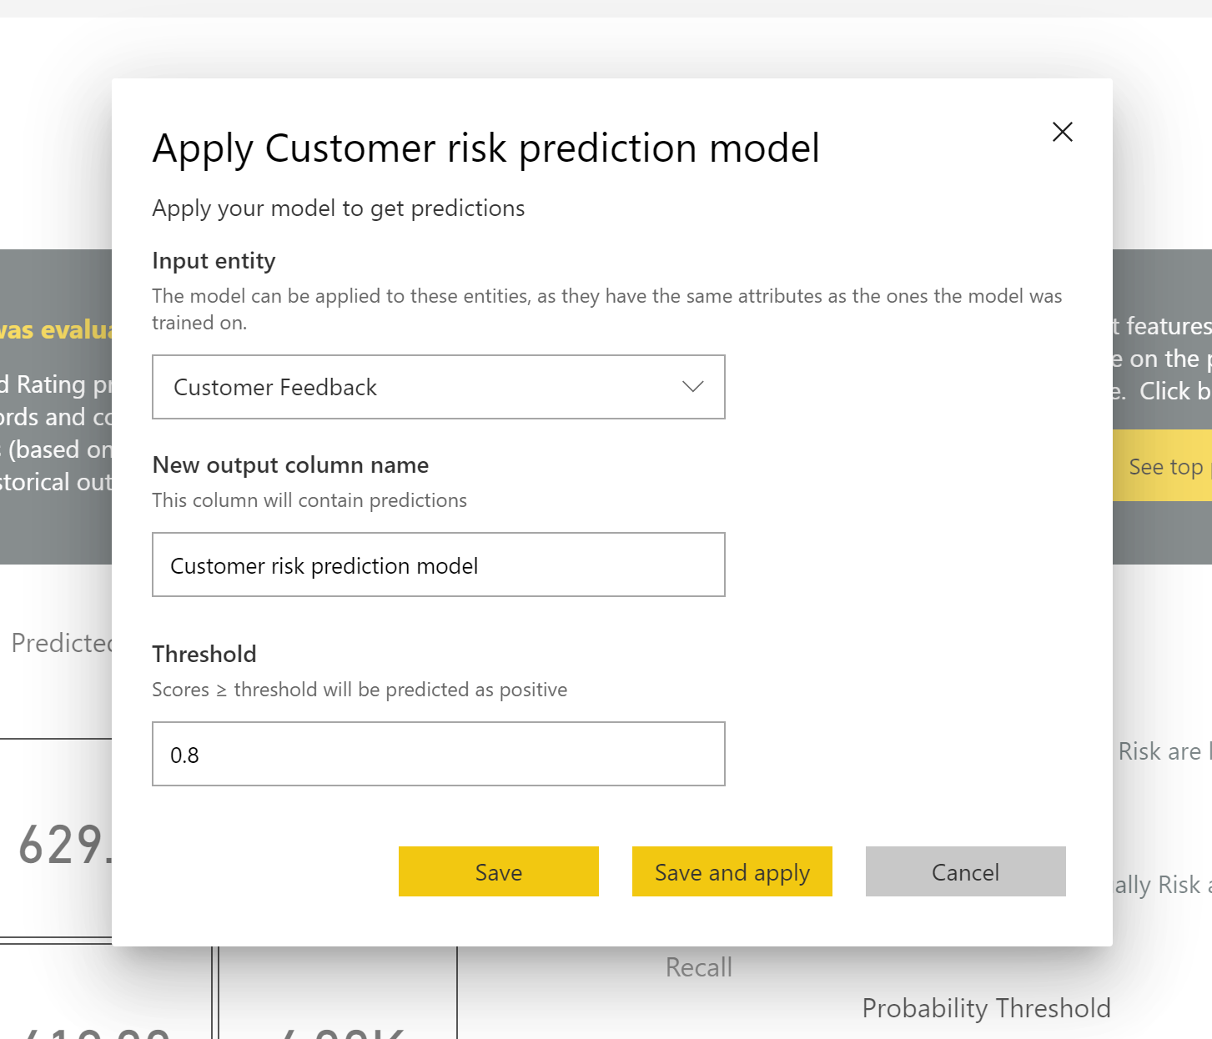
In the Apply dialog, you can specify the target entity that has the source data to which the model should be applied.
Refresh the dataflow when prompted to preview the results of your model.
Notes:

Slide 21
Objective: View results of applying the model
Once the dataflow refresh is completed, you can select the Customer Risk Classifier enriched Purchase Intent Prediction entity to view the results.
Notes:

